Slide 1
CSE 3666 Exam 1 Review
The exam will cover the topics from Lectures 1.1-1.9.

Slide 2
Problem 1
Multi-choices (several);
True or False (several);
Problem 2. (a)-(c) Multi-blanks;
Problem 3. short answers;
Problem 4. Essay;
Problem 5. Essay
Problem 6. Essay

Slide 3
Numbers, bits, bytes, and ASCII characters
Binary numbers, two’s complement numbers, hexadecimal numbers.
Conversion between different number systems, including decimal numbers, binary, hexadecimal.
Signed and unsigned extension.
Addition/subtraction of binary/two’s complement numbers. Negate a two’s complement number.
Bitwise logical operations.
ASCII characters.

Slide 4
RISC-V ISA
Skill: Be extremely familiar with a set of core MIPS instructions, understand their operations, and use them properly.
RISC-V instructions sets. Arithmetic, logical, memory, control flow instructions.
Instruction class | RISC-V examples
Arithmetic | add, sub, addi…
Data transfer | lw, sw, lb, lbu, sb lh, lhu, lui…
Logical | and, or, xor, andi, ori, sll, sra…
Cond. Branch | beq, bne…
Jump | Jal, jalr…

Slide 5
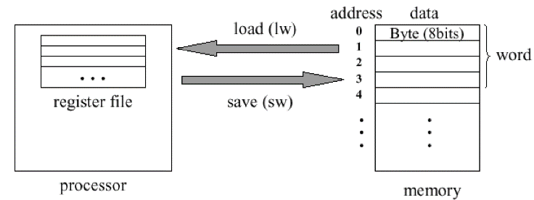
Data
Skill: Properly specify operands in instructions and access data in programs.
1. Accessing data in registers and memory.

Slide 6
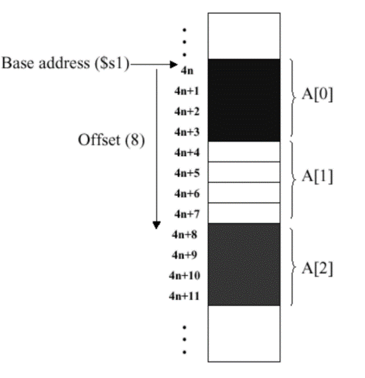
Array in memory. Array of words, half-words, and bytes (characters).

Slide 7
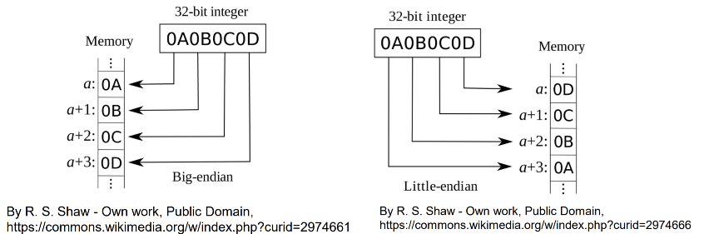
Data of different sizes. Sign extension. Endianness.

Slide 8
Control flow
Skill: given enough information, encode MIPS instruction with 32 bits and understand encoded instructions.
Program counter.
RISC-V support for if-then-else, loops, functions.
Compare values with beq,bne, etc.
RISC-V calling convention. Caller-saved /callee-saved registers. Passing parameters to / returning value from functions.
Stack. Push/pop. Save/restore registers on stack. Allocate storage space on stack.

Slide 9
Stack operations
#push x1
addi sp, sp, -4
sw x1, 0(sp)
# pop x2
lw x2, 0(sp)
addi sp, sp, 4
Push
Pop
sp
sp
sp
sp
x2
x2
x2
x1
x1

Slide 10
push multiple words
Write RISC-V instructions to push s1, s2, and s3 onto the stack
Instead of 3 ADDI’s, we can adjust sp once for three words
# reserve space for 3 words
addi sp, sp, -12
sw x1, 8(sp)
sw x2, 4(sp)
sw x3, 0(sp)
 | Address | Value
 | 0x7FFF 901C
 | 0x7FFF 9018
 | 0x7FFF 9014
 | 0x7FFF 9010
 | 0x7FFF 900C
 | 0x7FFF 9008
 | 0x7FFF 9004
 | 0x7FFF 9000
Before push
sp
x1
x1
x2
x2
x3
x3
sp

Slide 11
push multiple words
Write RISC-V instructions to push s1, s2, and s3 onto the stack
Instead of 3 ADDI’s, we can adjust sp once for three words
# pop x1, x2, and x3
lw x1, 8(sp)
lw x2, 4(sp)
lw x3, 0(sp)
addi sp, sp, 12
 | Address | Value
 | 0x7FFF 901C
 | 0x7FFF 9018
 | 0x7FFF 9014
 | 0x7FFF 9010
 | 0x7FFF 900C
 | 0x7FFF 9008
 | 0x7FFF 9004
 | 0x7FFF 9000
x1
x1
x2
x2
sp
x3
x3
Before pop sp

Slide 12
Assembly code
Translate pseudocode or simple C code to RISC-V assembly code.
Understand/debug RISC-V code.

